Slide 1

Scalar & Homoskedastic Models for SAR & POLSAR data
presented by
Thanh-Hai Le
PhD Candidate
School of Computer Engineering
Sept 2014

Slide 2
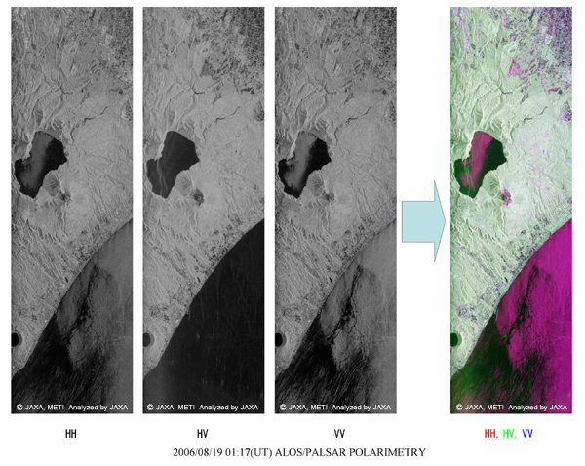
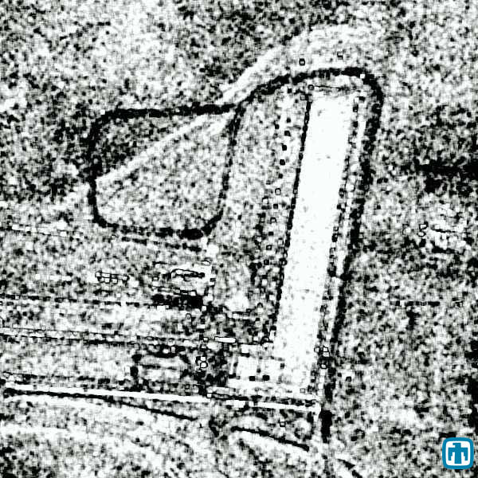
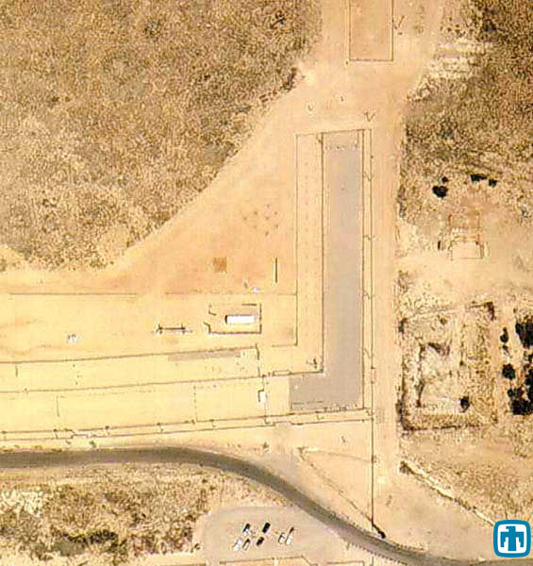
Introduction:
Notes:
Time: 2-3 minutes
Content Overview: MH370 as the need to improve POLSAR data processing
http://www.themalaysianinsider.com/malaysia/article/govt-urged-to-get-sophisticated-radar-detectors-in-mission-to-find-mh370

Slide 3
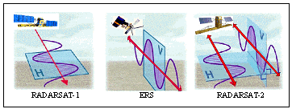
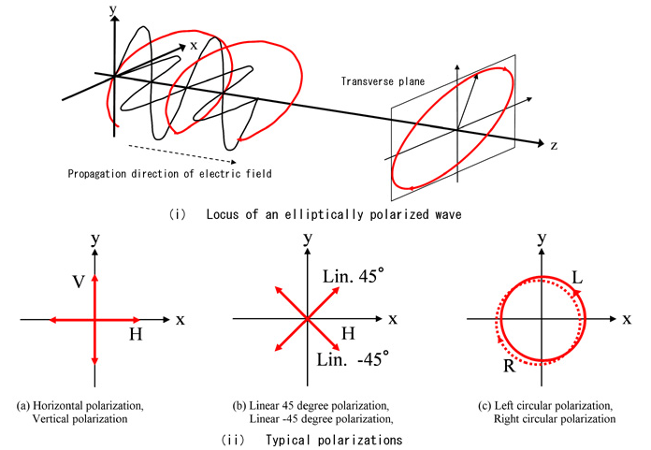
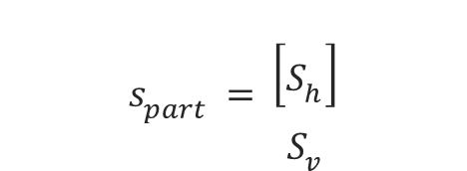
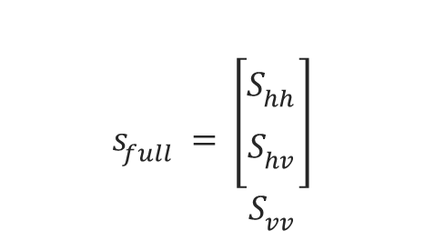
POLSAR: Wave Polarization
Notes:
This slide (1 min) intro: s_part, s_full, c_part, c_full,
these are different from optical physics

Slide 4
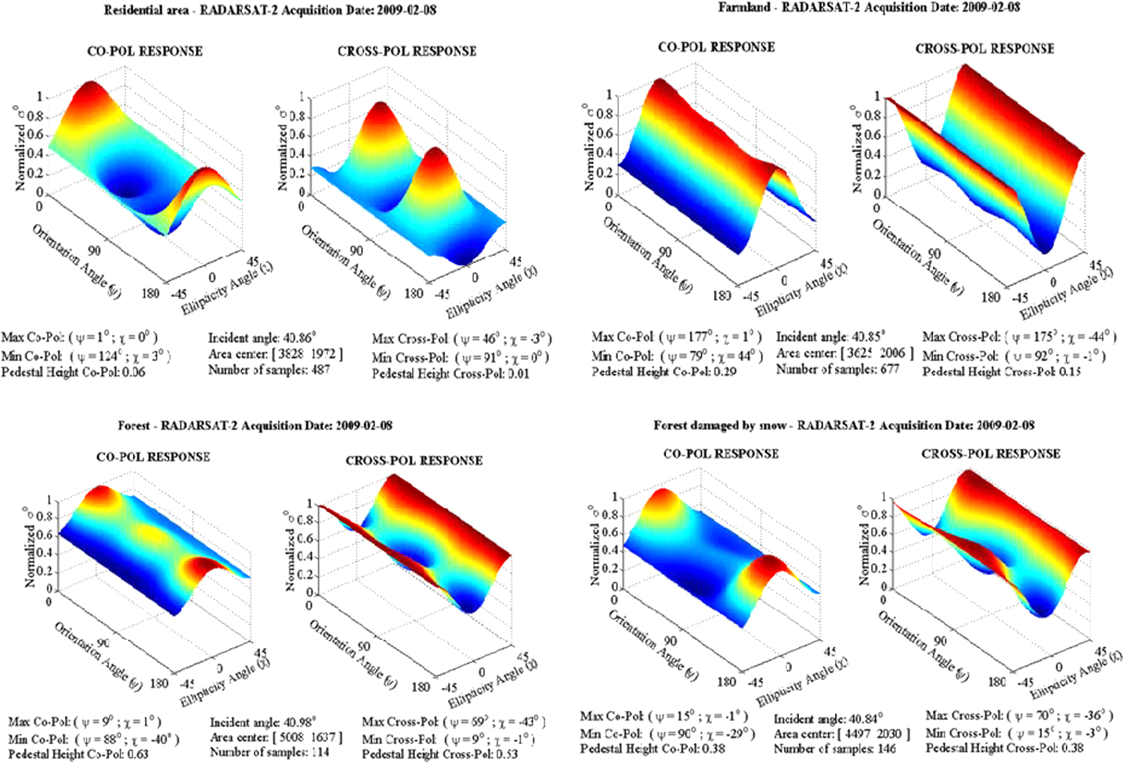
How to compare POLSAR signature?
Notes:
SAR is one dimensional and stochastic
POLSAR dataset is multi-dimensional and stochastic.
Still scalar discrimination measures are needed, e.g. to classify or detect changes in POLSAR data

Slide 5

Related work (for scalar models): 2-3 mins

Slide 6
Published Scalar Models (Complex & unintuitive)
from model: none satisfying 1) being representative 2) result in discrimination measure

Slide 7
Published Discrimination Models
1) what is representative? determinant and trace
2) based on precise model? No only asymptotic

Slide 8
Body: 6-9 mins
This slide: basic Complex Wishart model, Wilk model and Goodman’s result

Slide 9
Determinant model, Determinant ratio model
Our result

Slide 10
Dispersion and Contrast model
Our result

Slide 11
Traditional SAR models
As special case of proposed generic model

Slide 12
Conclusion: Scalar Models Proposed
Wrap up: 1 min: pros and cons (not physical phenomena, not physicist)

Slide 13
Homoskedastic models: 10 minutes
This slide: Intro - problem description: 1 min
  POLSAR narrow distribution,
  Vicious circle in SAR speckle filtering

Slide 14
Related work: 1-2 mins

Slide 15
Body: 5-6 mins
This slide our model (math)

Slide 16
Body (Cont)
Show consistent homoskedastic histogram vs. inconsistent heteroskedastic histogram

Slide 17
Wrap up: 1 min

Slide 18
Applications: 3-4 minutes
This slide: kMLE: 1 min

Slide 19
Applications (fMLE: 1 min)

Slide 20
Applications (MSE: 1 min)

Slide 21
Applications (ENL: 1 min)

Slide 22
Applications SAR -> POLSAR: 1 min

Slide 23
Conclusion & QA: 1-2 minutes

